Slide 1
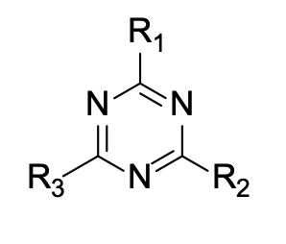
MPRO | Meeting with Amadeu Group
The main scaffold that the group utilized was a triazine
They synthesized and tested around 200 triazines
The results splits the triazines into 2 groups:
A enzymatic + cellular activity (24)
B Cellular activity only (167)
The ones from B might be targeting another element of SARS2
They measure activity with EC50 and EC90 (drug concentration that inhibits 90% of the virus).
Most compounds displayed a high EC90 as compared with EC50 values, showing inefficiency to completely control the infection.
Collaborators:
Crystallization with Dr. Coll’s group
NMR interaction studies with Prof. Schwalbe’s group
20/07/2023

Slide 2
MPRO | Meeting with Amadeu Group
NMR studies on group A :
21 ligands tested for binding to MPRO with NMR (only 3 shown promising results).
MPRO 306 aa with 87,7% of them assigned to NMR peaks. They actually used 80.9% of MPRO aa to detect binding.
They could measure changes in the peaks of these 80.9% of aa for 3 triazines
MCS-1361: A191-Q192 (S4), G174-T175 (-), E166 (S4), T135 (-), C117 (-), Q107 (-), S10 (-)
MCS-1258: A173 (-), C117 (-), C38 (-)
MCS-1327: A191-Q192 (S4), E166 (S4), Q299-S301 (-), M82 (~S2), V86 (S2), C117(-), D48 (~S1’)
Looks like MCS-1361 and MCS-1327 are actually binding to the MPRO active site not sure about 1258 which also have a very low signal
20/07/2023

Slide 3
MPRO | Meeting with Amadeu Group
Hypothesis for group B compounds:
They are RNA binders
24 candidates (6 with EC50 < 1.8 uM and 18 with EC50 between 1.8-13 uM)
13 where send to Schwalbe for NMR studies against RNA 5’SL1234
4 discarded for solubility issues
6 were identified as hits
20/07/2023

Slide 4
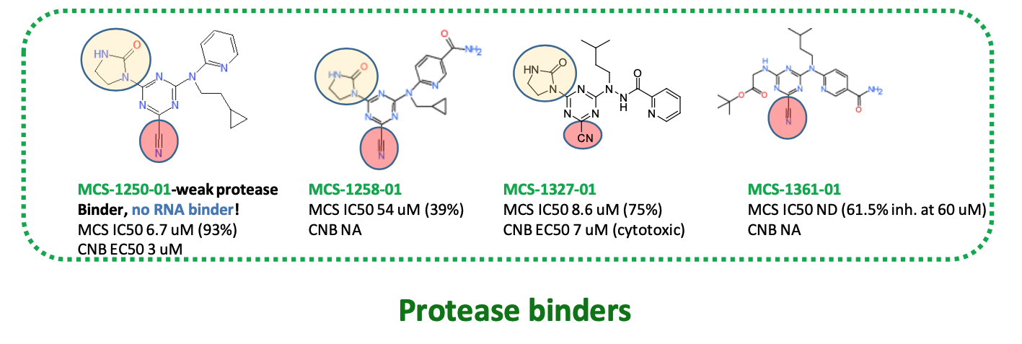
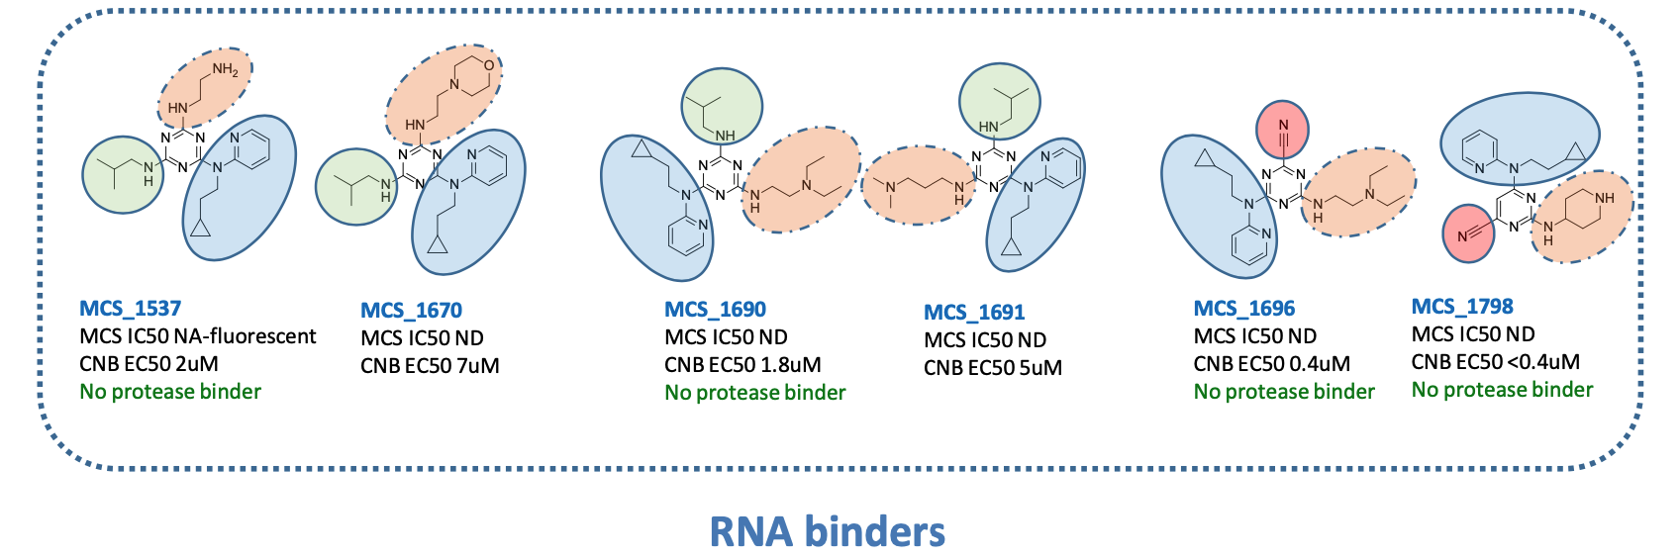
MPRO | Meeting with Amadeu Group
20/07/2023

Slide 5
MPRO | Paper SARS2 RNA druggability from Schwalbe
Introduction:
+ single-stranded RNA genome of 30k nucleotides.
15 structured RNA elements (fold independently) conserved between SARS and SARS2
Most screening campaigns focusing proteins to stop viral propagation
Very few attempts trying to target large viral RNA genome
In SARS, the pseudoknot (PK) RNA involved in ribosomal frameshifting was identified as target
SCoV-2 is discussed to contain numerous potential druggable sites.
Only 3 screenings against structured RNA in SARS2
They performed a NMR-based screening of 768 compounds against 15 structured RNAs of SARS2
They select the most promising among the 15 structured RNA elements as a potential drug target
They identify secondary structure in these 15 RNA targets as well as describe its functional role
16/08/2023
Angew. Chem. Int. Ed. 2021, 60, 19191– 19200 DOI: doi.org/10.1002/anie.202103693

Slide 6
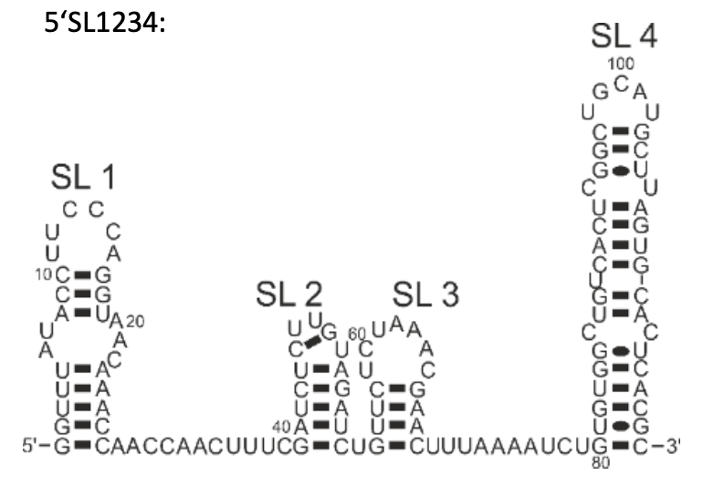
MPRO | Paper SARS2 RNA druggability from Schwalbe
Results and Methods
5’-SL1234 RNA fragment:
5-SL1 is associated with viral mRNA escape from NSP1-mediated translational shut-down
5-SL2-3 harbors a stringent conserved stem-loop and the transcription regulatory sequence regulating the production of subgenomic RNA that is embedded within a second, more labile stem-loop
5-SL1-4 stem-loop indispensable for replication and contains a short upstream open reading frame uORF
16/08/2023
Angew. Chem. Int. Ed. 2021, 60, 19191– 19200 DOI: doi.org/10.1002/anie.202103693

Slide 7
MPRO | Paper SARS2 RNA druggability from Schwalbe
4 different classes of non-canonical RNA segments were identified amongst the 15 RNA elements:
i) Capping loops (blue or grey) (6nts long and uridine enriched while adensine depleted)
ii) Bulges/internal loops (green) which dictate the relative orientations of helical segments. Key elements in RNA tertiary structure and often interaction sites for proteins, RNAs, metal ions or molecules. These bulges interrupt helical segments by single or stretches of unpaired nct.
iii) Base-pairs mismatches (orange). They also disrupt A-helical conformations
iv) 3-helix junctions (pink).
16/08/2023
Angew. Chem. Int. Ed. 2021, 60, 19191– 19200 DOI: doi.org/10.1002/anie.202103693

Slide 8
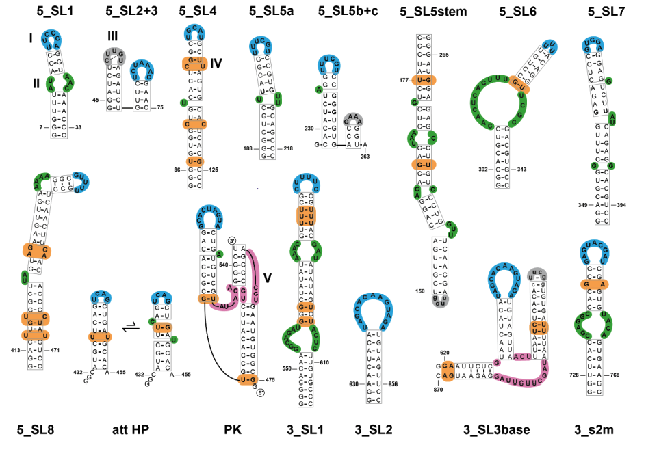
MPRO | Paper SARS2 RNA druggability from Schwalbe
Secondary structures in these RNA targets (Supporting Information, Figure S1) by NMR spectroscopy.
Capping loops (blue or grey)
Bulges/internal loops (green)
Base-pairs mismatches (orange)
3-helix junctions (pink)
16/08/2023
Angew. Chem. Int. Ed. 2021, 60, 19191– 19200 DOI: doi.org/10.1002/anie.202103693

Slide 9
MPRO | Paper SARS2 RNA druggability from Schwalbe
DSI-poised library (DSI-PL):
768 highly diverse and poised (easy synthesis?) molecules
Already tested for MPRO
NMR-based screening
Binding mixtures from 5-20 compounds with minimal signal overlap. They clusterized the library (how?) to obtained 400 clusters of which 200 singletons. Then 64 mixtures with 12 compounds (randomly chosen).
Ligand-observed H-NMR experiments of the 64 mixtures against the 15 RNA elements + 5 larger RNAs (compromising several RNA elements)
Ligands were assigned as a hit if two of the three criteria were satisfied.
40 compounds bind to the 15 RNA elements and 29 to the 4-multi-elements RNA. In total 108 binding events
16/08/2023
Angew. Chem. Int. Ed. 2021, 60, 19191– 19200 DOI: doi.org/10.1002/anie.202103693

Slide 10
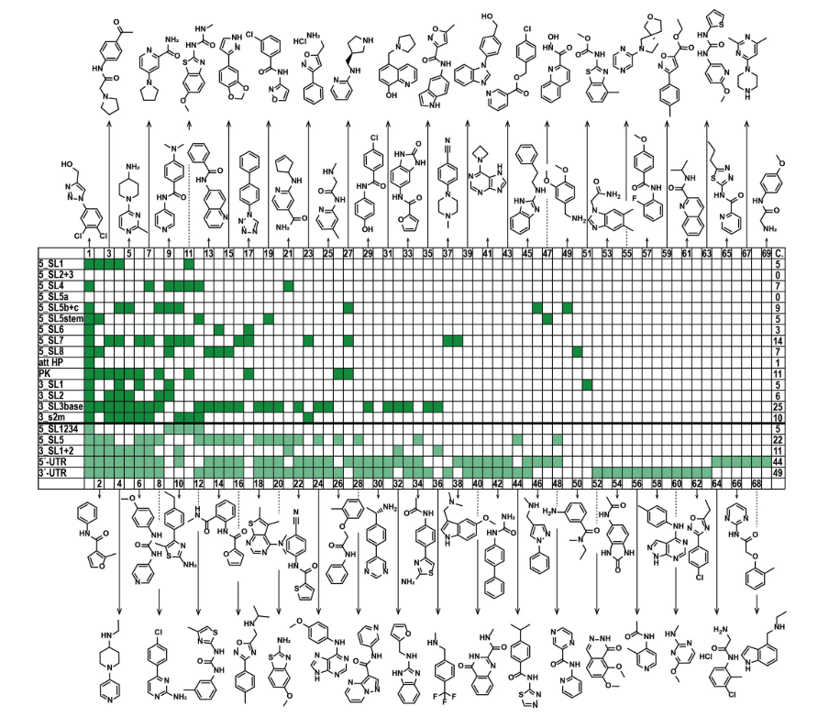
MPRO | Paper SARS2 RNA druggability from Schwalbe
16/08/2023
Angew. Chem. Int. Ed. 2021, 60, 19191– 19200 DOI: doi.org/10.1002/anie.202103693

Slide 11
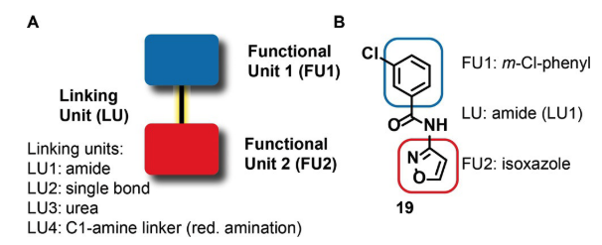
MPRO | Paper SARS2 RNA druggability from Schwalbe
They do not observe a clear correlation between the number of helical residues (loops, bulges, …) in an RNA and the number of hits.
Molecular descriptors between binders and non-binders are the number of aromatic rings and the sp3-character of the compounds. In general binders have one to three aromatic rings and less sp3-carbons atoms
30 out of 40 molecules have a modular architecture. They consist of two functional units, which are mainly disubstituted rings of the size 5 and 6 and connected by four different types of linker units.
Hits containing two functional units can be classified into four
additional classes.Class 2: five-membered heterocyclic rings
containing a single nitrogen heteroatom, Class 3: five-membered
rings with several heteroatoms,in particular nitrogen, oxygen and
sulfur,Class 4: six-membered heterocyclic rings containing
nitrogen atom(s), and Class 5: substituted and unsubstituted benzenes.
16/08/2023
Angew. Chem. Int. Ed. 2021, 60, 19191– 19200 DOI: doi.org/10.1002/anie.202103693

Slide 12
MPRO | Paper SARS2 RNA druggability from Schwalbe
Conclusions:
Results show that the fragments of the DSI-PL can cover almost the entire structural space of the viral RNA genome.
Thus,the SCoV-2-RNA genome can be targeted by ligands of low molecular weight.
Assuming that increasing structural complexity enhances the potential to achieve specificity for small molecules, among the 15 RNAs, PK and 3_SL3base represent the most promising targets for follow-up development of lead molecules.
NMR as primary screen because it not only provides information on chemical purity of both ligand and RNAtarget, but also on affinity and binding site.
Further,our approach relies on the hypothesis that the viral genome can be specifically targeted even in the presence of human cellular RNA. However, given all these theoretical considerations it is striking to recognize that small molecules have been developed that target splicing in a highly specific manner.
16/08/2023
Angew. Chem. Int. Ed. 2021, 60, 19191– 19200 DOI: doi.org/10.1002/anie.202103693

Slide 13
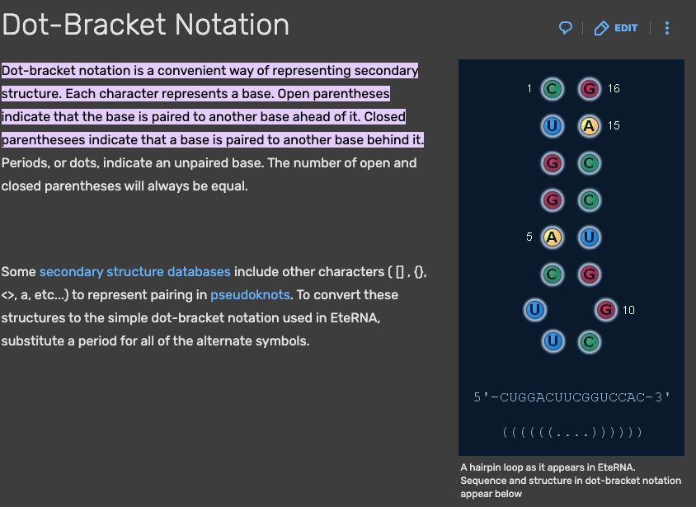
MPRO | Paper SARS2 RNA druggability from Schwalbe
Info to gather
Get the affinity of the ~768 compounds against the 5-SL1, 5-SL2-3, 5-SL4 and 5-SL1234 RNA elements
Get the sequence of the 15 RNA segments with all secondary structure information (dot-braket notation) and position in the genome
Get the complete SARS2 genome
16/08/2023
Angew. Chem. Int. Ed. 2021, 60, 19191– 19200 DOI: doi.org/10.1002/anie.202103693

Slide 14
MPRO | Paper SARS2 RNA de novo 3D models
Introduction
The SARS2 RNA genome harbors conserved regions predicted to have stable secondary structures and verified by chemical probing and some essential for the life cycle of related beta coronaviruses.
RNA genome regions change long-range contacts with other RNA elements or form interactions with viral and host proteins at different steps of replication, translation, and packaging.
A possible therapeutic strategy is therefore to find drugs that stabilize an RNA element in a particular conformation incompatible with conformational changes and/or changing interactions with biological partners at different stages of the complete viral replication cycle.
They provide de novo modeled structure ensembles for conserved RNA elements in the SARS-CoV-2 genome obtained from Rosetta’s protocol for Fragment Assembly of RNA with Full-Atom Refinement, version 2 (FARFAR2)
de novo models for stem loops 1 to 8 (SL1–8) in the extended 5 UTR, the reverse complement of SL1–4 in the 5 UTR, the FSE and its dimerized form, the 3 UTR pseudoknot, and the 3 UTR hypervariable region, along with homology models of SL2 and s2m.
16/08/2023
Rangan, Ramya et al. Nucleic acids research vol. 49,6 (2021): 3092-3108. doi:10.1093/nar/gkab119

Slide 15
MPRO | Paper SARS2 RNA de novo 3D models
Methods
Beginning with a sequence and secondary structure, FARFAR2 generates models through Monte Carlo substitutions of 3-residue fragments sampled from previously solved RNA structures, followed by refinement in a high-resolution physics-based free energy function, which models hydrogen bonding, solvation effects, nucleobase stacking, torsional preferences and other physical forces known to impact macromolecule structure.
The models were created using the rna denovo application in Rosetta 3.12 using default parameters for FARFAR2
We make available up to 50 models from each of the 10 lowest energy clusters in the resulting FARFAR2-SARS-CoV-2 dataset to help efforts in virtual screening that take advantage of ensembles.
Validation was based on convergency
16/08/2023
Rangan, Ramya et al. Nucleic acids research vol. 49,6 (2021): 3092-3108. doi:10.1093/nar/gkab119

Slide 16
MPRO | Paper SARS2 RNA de novo 3D models
Results
The SHAPE and DMS reactivity profiles for the 5 UTR collected by different research groups across in vitro and in vivo probing conditions showed remarkable consistency across datasets
Secondary structure determined by NMR differs from the secondary structure derived from homology modeling to the SARS1 s2m crystal structure
Some of the stems in the extended 5´ UTR have structural preferences that have proven critical to the viral life cycle based on genetic experiments in other betacoronaviruses:
SL1: Prior genetic selection experiments have demonstrated a preference for mutations that destabilize SL1. The lower part of this stem must unpair to allow for the formation of a long-range RNA contact between the 5 and 3 UTRs. The stem must also presumably unfold to enable cap-dependent initiation of translation by the human ribosome. Recent work has found that SL1 is required for protecting SARS-CoV-2mRNA from translation repression by SARS-CoV-2 protein nsp1, with SL1 likely binding to nsp1as in SARS-CoV-1
16/08/2023
Rangan, Ramya et al. Nucleic acids research vol. 49,6 (2021): 3092-3108. doi:10.1093/nar/gkab119

Slide 17
MPRO | Paper SARS2 RNA de novo 3D models
Results
2) SL2: The loop in SL2 has features consistent with a U-turn conformation across all beta coronaviruses, and mutations that disrupt this are not viable, leading to a loss of sub-genomic RNA synthesis
3) SL3: has the transcription regulation sequence of the leader (TRS-L), which must be available to base-pair with TRS-B in the negative-strand viral genome to facilitate sub-genomic RNA synthesis.
4) SL4: has a proposed role in directing the synthesis of sub-genomic RNA in other beta coronaviruses, and also harbors an upstream open reading frame (uORF) across many beta coronaviruses.
5) SL5: is a well-established domain that, in SARS-related viruses, has a long stem elaborated with a
four-way junction; this element has been proposed to harbor packaging signals, and it harbors the AUG start codon for the genome’s first gene product, the ORF1a/b polyprotein.
6) SL6-7: Downstream of the AUG start codon, SL6 and SL7 are predicted by all chemical mapping studies of the 5UTR, and are analogous to stems discovered to be important in bovine coronaviruses but not yet functionally probed in SARS-related viruses
7) SL8: is also predicted by NMR and DMS, though its function in SARS2 is unknown.
16/08/2023
Rangan, Ramya et al. Nucleic acids research vol. 49,6 (2021): 3092-3108. doi:10.1093/nar/gkab119

Slide 18
MPRO | Paper SARS2 RNA de novo 3D models
Results
They produced models for the full extended 5 UTR. With the current level of sampling, each of these lowest energy structures appear only once amongst the models, reducing confidence that these models accurately capture lowest energy conformations. Nevertheless, the top-scoring models suggest the potential for compact RNA structures for the 5 UTR mediated by potential tertiary contacts between stem–loops.
While such tertiary contacts are of potential interest, additional experimental data would be needed to have confidence that any such collapsed states are well-defined low energy states and could act as therapeutic targets.
It is also possible that the entire 5 UTR may form a well-defined 3D arrangement when in complex with the ribosome, which would not be captured by our modeling.
We therefore turned to smaller segments of the extended 5 UTR for which Rosetta-FARFAR2 had a reasonable prospect of achieving convergent models.
16/08/2023
Rangan, Ramya et al. Nucleic acids research vol. 49,6 (2021): 3092-3108. doi:10.1093/nar/gkab119

Slide 19
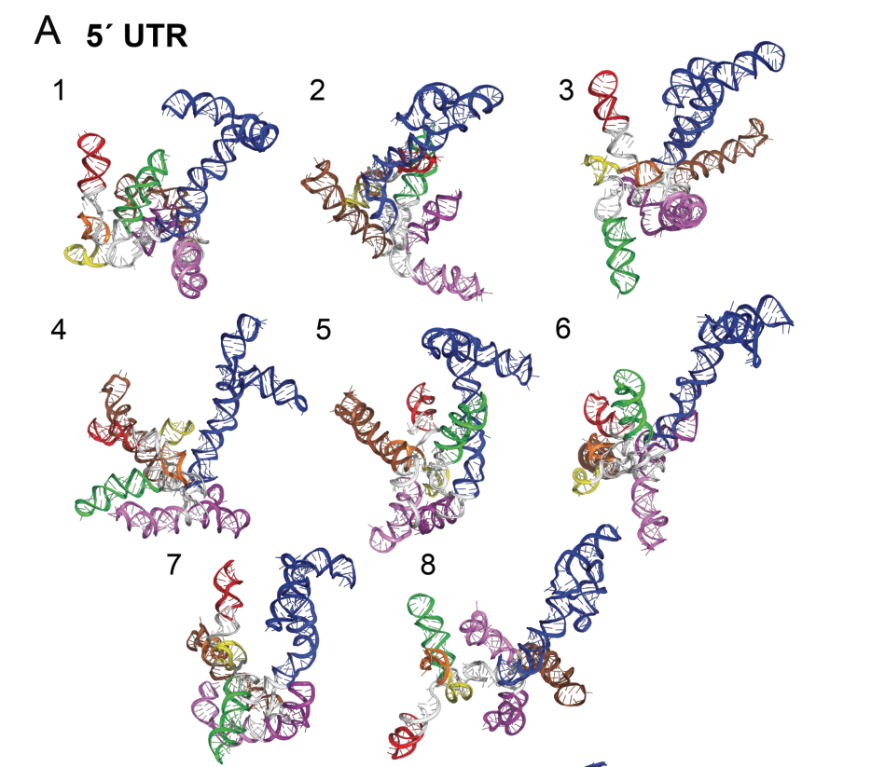
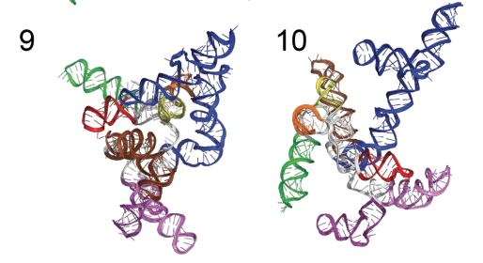
MPRO | Paper SARS2 RNA de novo 3D models
16/08/2023
Rangan, Ramya et al. Nucleic acids research vol. 49,6 (2021): 3092-3108. doi:10.1093/nar/gkab119

Slide 20
MPRO | Paper SARS2 RNA de novo 3D models
Results
For the shorter stem–loops in the 5 UTR and initial stretch of the ORF1a/b coding region, including SL1, SL2, SL3, SL4, SL6 and SL7, we generated at least 200 000 FARFAR2 models.
As expected for these smaller RNA segments, all these stem loops had excellent modeling convergence.
Most clusters had occupancies of greater than 1, indicating that numerous independent de novo modeling trajectories resulted in conformations similar to within 2 ˚A RMSD. Furthermore, the mean pairwise RMSD of 10 lowest energy cluster centers approached 2.5A˚ or better for SL1–4, suggesting that if a single dominant structure exists for these elements, our average model accuracy would be around 6A RMSD or better.
Nevertheless, SL1–3 have four or more clusters with E-gap values <1REU, suggesting the presence of many distinct structures at a 2A˚ clustering radius. We propose that these clusters represent alternative structural targets that may be trapped by a small molecule without substantial energetic penalty.
16/08/2023
Rangan, Ramya et al. Nucleic acids research vol. 49,6 (2021): 3092-3108. doi:10.1093/nar/gkab119

Slide 21
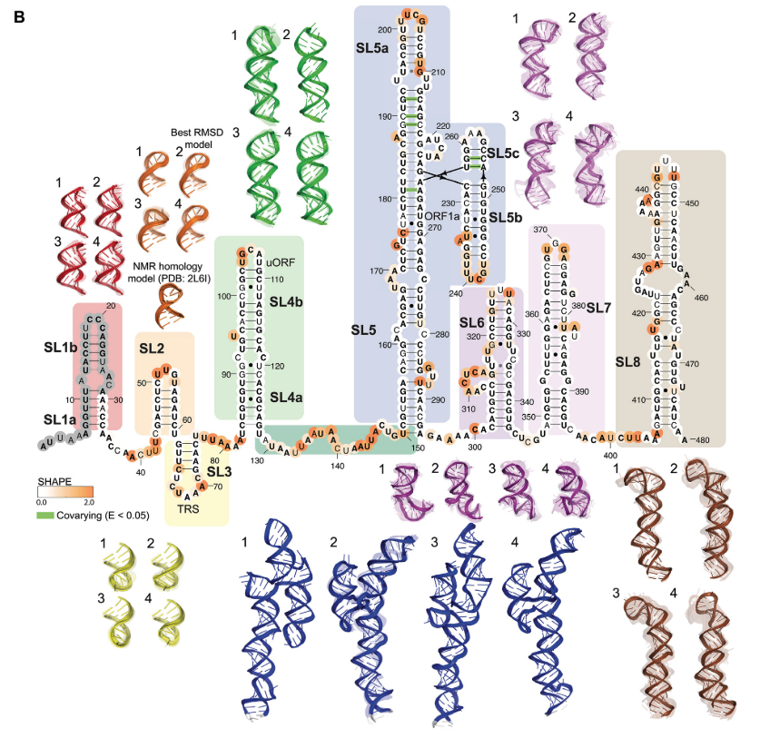
MPRO | Paper SARS2 RNA de novo 3D models
16/08/2023
Rangan, Ramya et al. Nucleic acids research vol. 49,6 (2021): 3092-3108. doi:10.1093/nar/gkab119

Slide 22
MPRO | Paper SARS2 RNA de novo 3D models
Results
Other SARS2 RNA models:
Reverse complement of SL1–4 (no ss experimental information)
SARS-CoV-2 frameshift stimulating element (FSE): The SARS-CoV-2 FSE pseudoknot structure has been shown to be critical for a ribosomal frameshifting event that leads to the production of ORF1a and ORF1b proteins from the same genomic region (Figure 3)(49). The FSE has been the target of many recent structural characterization efforts.
Models of SARS-CoV-2 3 UTR
16/08/2023
Rangan, Ramya et al. Nucleic acids research vol. 49,6 (2021): 3092-3108. doi:10.1093/nar/gkab119

Slide 23
MPRO | Paper SARS2 RNA de novo 3D models
Conclusions
The structural ensembles presented here have a number of limitations.
First, these ensembles are not true thermodynamic ensembles in that the structure occupancies do not necessarily reflect the underlying probabilities of occurrence for each conformational state.
Second, some of the simulation ensembles described here did not achieve sufficient convergence to provide confidence in the resulting models that is, independent modeling runs did not converge to similar low energy structures. It is possible that these RNA elements do not have well-defined 3D structures in solution unless bound tightly to partners such as the SARS-CoV-2 replicase complex.
A third limitation of the structural ensembles presented here is that the most converged models in this study reach an expected RMSD of 5–10 A˚ from the native structure, potentially presenting difficulties for small-molecule virtual docking approaches where the accuracy depends on a high-resolution model of the binding site
The resulting FARFAR2-Apo-Riboswitch dataset provides an opportunity for testing the accuracy of virtual screening approaches that use FARFAR2 model sets.
16/08/2023
Rangan, Ramya et al. Nucleic acids research vol. 49,6 (2021): 3092-3108. doi:10.1093/nar/gkab119

Slide 24
MPRO | Paper SARS2 RNA de novo 3D models
Info to gather
ALL models for all RNAs
16/08/2023
Rangan, Ramya et al. Nucleic acids research vol. 49,6 (2021): 3092-3108. doi:10.1093/nar/gkab119

Slide 25
MPRO | Paper architecture of SARS2 RNA genome inside the virion
Introduction:
RNA structures are widely recognized as critical modulators in regulating transcription, translation, and replications of coronavirus and other RNA viruses
We recently developed an RNA in situ conformation sequencing technology, named RIC-seq, for unbiased mapping of RNA-RNA spatial interactions in living cells.
In this study, we successfully applied the vRIC-seq technology to the SARS2 RNA genome structure in intact virions. We reconstructed a model of the surprisingly compact yet unentangled tertiary structure of the SAR2 RNA genome.
At the secondary structure level, we found that the overall structure of SAR2 is more compacted in virion than that in the host cell, and long-range RNA duplexes are prevalently present.
SARS2 hijack host cells by engaging its spike with the host receptor. After entering into the host cell, the SARS2 genome is released from the densely coated N proteins for translating nonstructural proteins to replicate its genome, and to produce structural proteins to assemble new virions. If there is any genome structure remodeling before and/or after the infection is still unclear.
17/08/2023
Cao, Changchang et al. Nature communications vol. 12,1 3917. 24 Jun. 2021, doi:10.1038/s41467-021-22785-x

Slide 26
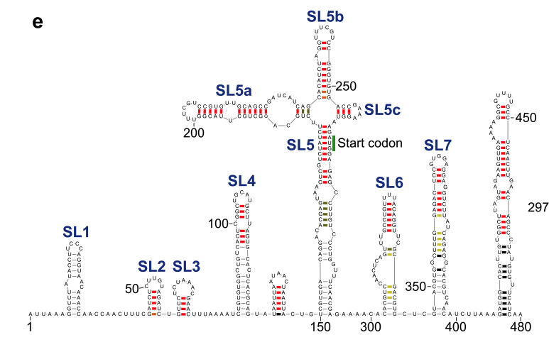
MPRO | Paper architecture of SARS2 RNA genome inside the virion
17/08/2023
Cao, Changchang et al. Nature communications vol. 12,1 3917. 24 Jun. 2021, doi:10.1038/s41467-021-22785-x

Slide 27
MPRO | Paper architecture of SARS2 RNA genome inside the virion
Results
90.6% of the pairwise interactions happened within 100 nt, whereas ~6.3% of the interactions spanned more than 600 nt, and three sharp peaks with 810, 1360, and 2090 nt separately, were observed
In our structural model, the median and mean distances between two paired regions in SARS-CoV-2 were 28 and 111 nt, respectively.
We found that about 63.8% (19,064 nt) of the SARS-CoV-2 genome were base-paired, and our model precisely recapitulated the stem-loop structures (SL1-SL7) in the 5′ UTR, as well as 3′ UTR structures including the s2m and the HVR (Fig. 3).
Unexpectedly, 76% of the duplexes identiﬁed by vRIC-seq in virion might also present in host cells. In addition, over 88% of the in-virion duplexes that happened within 2 kb were also present in host cells. However, the pairwise interactions over 2 kb showed evident remodeling in the host cells.
Notably, the duplexes in the 5′ UTR regions barely changed in virions and the host cells
17/08/2023
Cao, Changchang et al. Nature communications vol. 12,1 3917. 24 Jun. 2021, doi:10.1038/s41467-021-22785-x

Slide 28
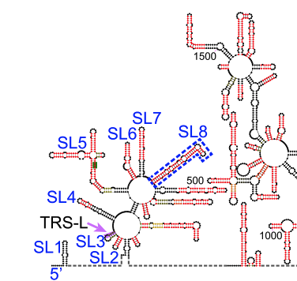
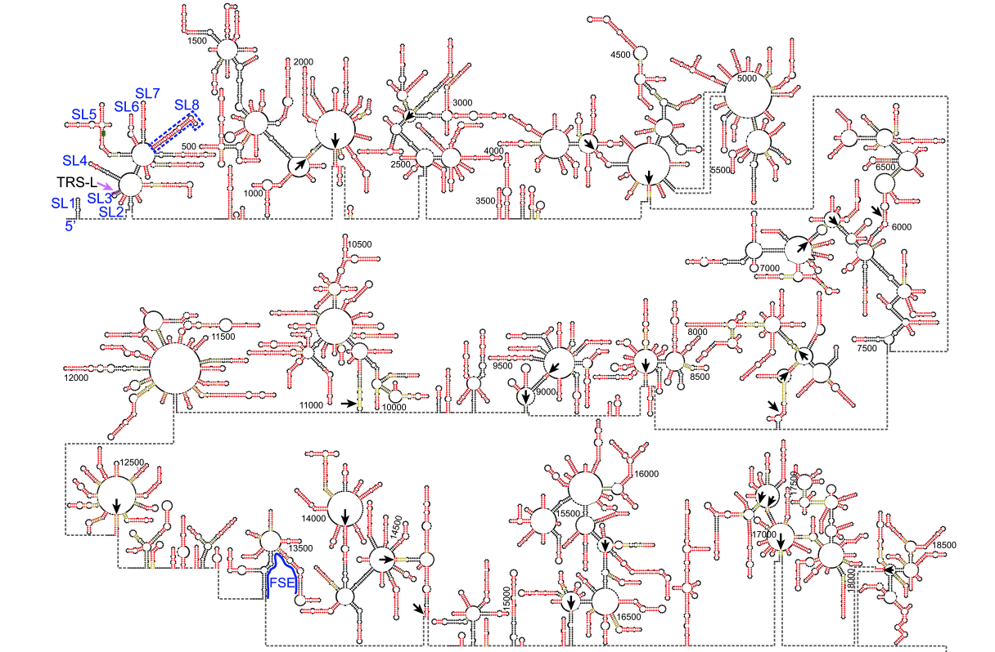
MPRO | Paper architecture of SARS2 RNA genome inside the virion
17/08/2023
Cao, Changchang et al. Nature communications vol. 12,1 3917. 24 Jun. 2021, doi:10.1038/s41467-021-22785-x

Slide 29
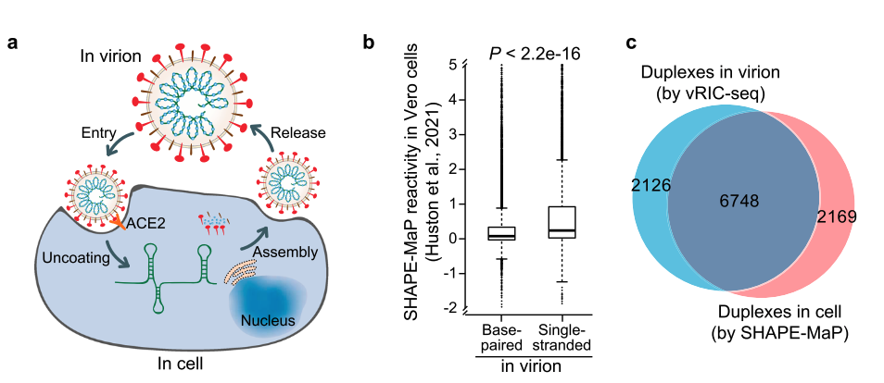
MPRO | Paper architecture of SARS2 RNA genome inside the virion
Eight co-variant base pairs were located at SL5-6 in the 5′ UTR
Next, we investigated the co-variant base pairs among 200,621 SARS-CoV-2 strains. This analysis identiﬁed 98 co-variant events across the whole SARS-CoV-2 genome, of which nine co-variants were located in SL1 and six in the s2m
17/08/2023
Cao, Changchang et al. Nature communications vol. 12,1 3917. 24 Jun. 2021, doi:10.1038/s41467-021-22785-x

Slide 30
MPRO | Paper architecture of SARS2 RNA genome inside the virion
Info to gather
ALL XLinks to validate models
17/08/2023
Cao, Changchang et al. Nature communications vol. 12,1 3917. 24 Jun. 2021, doi:10.1038/s41467-021-22785-x

Slide 31
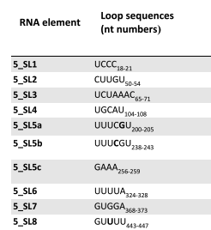
MPRO | Data
PDB:
Frameshifting pseudoknot RNA structures: at least 5 crystals
No structures for 5’UTR
Multiple structures of the replication-transcription complex bound to nsp13 + RNA
Nsp10-nsp14 complex + RNA
Backtracked complex + nsp13
Nucleotides for each segment of 5’UTR:
We used the following Genome from the Schwalbe first paper on the RNA secondary structure: https://www.ncbi.nlm.nih.gov/nuccore/NC_045512.2?report=fasta
We also used the the Supplementary Figure 1 from (Angew. Chem. Int. Ed. 2021, 60, 19191– 19200 DOI: doi.org/10.1002/anie.202103693 ) to select each 5’UTR segment
18/08/2023

Slide 32
MPRO | Data
We should be very very careful to known which Strain are they using for the experiments!
SL1: 7-33: GGUUUAUACCUUCCCAGGUAACAAACC
SL2+3: 45-75: AUCUCUUGUAGAUCUGUUCUCUAAACGAAC
SL4: 86-125: GUGUGGCUGUCACUCGGCUGCAUGCUUAGUGCACUCACGC
SL5a: 188-218: GGCUGCUUACGGUUUCGUCCGUGUUGCAGCC
SL5b+c: 230-263: CAUCUAGGUUUCGUCCGGGUGUGACCGAAAGGUA
SL5stem: 177-265: UAUCUUCUGCAGGCUGCUUACGGUUUCGUCCGUGUUGCAGCCGAUCAUCAGCACAUCUAGGUUUCGUCCGGGUGUGACCGAAAGGUAAG
SL6: 302-343: CACGUCCAACUCAGUUUGCCUGUUUUACAGGUUCGCGACGUG
SL7: 349-394: ACGUGGCUUUGGAGACUCCGUGGAGGAGGUCUUAUCAGAGGCACGU
SL8: 413-471: ACUUGUGGCUUAGUAGAAGUUGAAAAAGGCGUUUUGCCUCAACUUGAACAGCCCUAUGU
18/08/2023

Slide 33
MPRO | Data
Useful softwares for RNA (modeling and homology search)
http://rna.tbi.univie.ac.at/cgi-bin/RNAWebSuite/RNAfold.cgi
http://eddylab.org/infernal/
https://www.mankier.com/1/nhmmer#
https://iimcb.genesilico.pl/modernaserver/
https://rfam.org/
https://rfam.org/family/RF03117
There are no structures of the bCoV-5UTR family in Rfam
18/08/2023

Slide 34
MPRO | Data
Targeting 5’UTR:
The drugs and vaccines used to treat or prevent COVID-19 are predominantly targeted to the S protein, but the rapid mutation in this region can easily lead to drug resistance. Therefore, it is necessary to develop drugs that target other proteins (https://www.nature.com/articles/s41392-022-00884-5).
https://www.pnas.org/doi/10.1073/pnas.2117198119
https://onlinelibrary.wiley.com/doi/10.1002/anie.202103693
https://www.frontiersin.org/articles/10.3389/fchem.2021.802766/full
18/08/2023

Slide 35
MPRO | CASP15
First time there was a specific category for RNA modeling
10 RNA complexes
2 RNA-protein complexes
6 groups take part
Targets resolved by X-ray and cryo-EM
One of the structures was SARS-COV-2 5’SL5 (Also BtCoV-HKU5 SL5)
Coronaviruses have a highly structured 5′ region with several “stem loop” (SL) elements; SL5 was predicted to fold into a four-way junction in most SARS-related betacoronaviruses.
The tertiary organization of this junction and the degree of its structural conservation is unknown. In fact, previous computational modeling of the SARS-CoV-2 SL5 suggested that this domain might not have a well-defined tertiary structure.
Solved by cryo-EM at 4.74A (not great but it’s something)
Multiple models to represent experimental uncertainty
Not publicly available yet
22/08/2023
Kretsch, Rachael C et al. Proteins, 10.1002/prot.26550. 19 Jul. 2023, doi:10.1002/prot.26550

Slide 36
MPRO | SARS2 RNA genome and host proteins to target COVID infection
Introduction:
SARS-CoV-2 is an RNA virus and the RNA genome itself is a central regulatory hub that controls and enables its function. RNA molecules fold into complex, higher-order structures that are integral to their cellular function
Here, we investigated the in vivo and in vitro RNA secondary structures of SARS-CoV-2, as well as the structures of the UTRs of six related coronaviruses
Based on the in vivo structural data, we used our deep-learning tool to accurately predict 42 functionally related host proteins that bind to the UTRs of the SARS-CoV-2 RNA genome
We subsequently validated the physical and functional interactions of several proteins predicted to bind viral RNA. By using an innovative SARS-CoV-2 cell infection system and infection assays with the bona ﬁde SARS-CoV-2 virus, we validated that several of the conserved RNA structural elements do contribute to viral infection.
Also, we found that some of these host proteins are vulnerable drug targets; their chemical inhibition with repurposed FDA-approved drugs led to a signiﬁcant decrease in SARS-CoV-2 infection of cells.
22/08/2023
Sun, Lei et al. Cell vol. 184,7 (2021): 1865-1883.e20. doi:10.1016/j.cell.2021.02.008

Slide 37
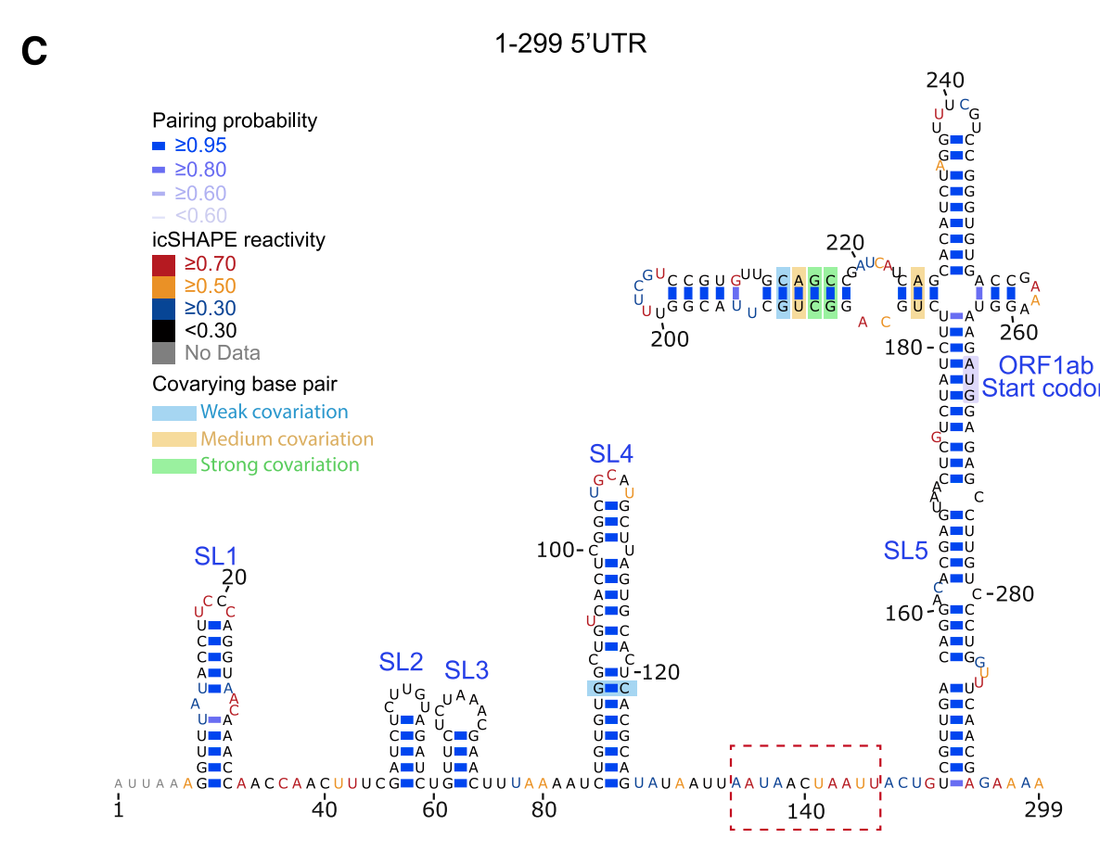
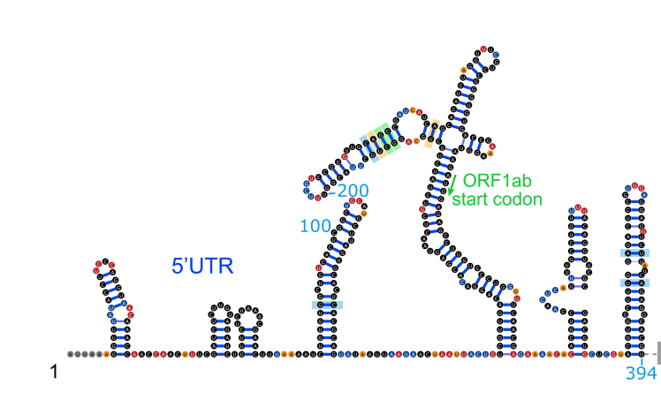
MPRO | SARS2 RNA genome and host proteins to target COVID infection
Results:
structural landscape of the SARS-CoV-2 genome in human cells
host cell data conﬁrm the presence of stable, conserved structural elements from theoretical analysis
accurately predicted 42 functionally related host cell proteins that bind to the SARS-CoV-2 RNA genome and showed that some of these host proteins are vulnerable drug targets for reducing SARS-CoV-2 infection
The 5 UTR of most coronaviruses harbors a number of stem loops, with many showing heightened sequence conservation across betacoronaviruses, and various stems demonstrating functional roles in viral infection. For example, studies suggested that SL1 in the 5 UTR is necessary for coronavirus replication . The third stem loop contains a TRS core sequence (CS region, CUAAAC), which has been speculated to be critical for the discontinuous transcription characteristic of coronaviruses.
22/08/2023
Sun, Lei et al. Cell vol. 184,7 (2021): 1865-1883.e20. doi:10.1016/j.cell.2021.02.008

Slide 38
MPRO | SARS2 RNA genome and host proteins to target COVID infection
Results:
In addition to recruiting the translation machinery, SARS-CoV-2 could interact with many host proteins including RNA metabolism proteins and enzymes such as helicases.
For example, based on our predictions, the helicase DDX42 is likely hijacked by the virus to help evade cell innate immune response
Interestingly, our ﬁndings suggest that stress granule proteins including TIA1, IGF2BP1, and PTBP1 interact with the SARS-CoV-2 RNA genome.
The identiﬁcation of conserved RNA structures and host RBPs that bind to viral RNA genomes can be exploited to develop antiviral drugs. We found inhibitor drugs targeting predicted host factor proteins successfully reduced SARS-CoV-2 infection.
22/08/2023
Sun, Lei et al. Cell vol. 184,7 (2021): 1865-1883.e20. doi:10.1016/j.cell.2021.02.008

Slide 39
MPRO | Sequencia de RNA del grup experimental
5'SL1234:
5'-
GGUUUAUACCUUCCCAGGUAACAAACCAACCAACUUUCGAUCUCUUGUAGAUCUGUUCUCUAAACGAACUUUAAAAUCUGUGUGGCUGUCACUCGGCUGCAUGCUUAGUGCACUCACGC
- 3'
It is the one used in Angew. Chem. Int. Ed. 2021, 60, 19191– 19200 DOI: doi.org/10.1002/anie.202103693 (first paper of Schwalbe (experimental collaborator) on SARS2 RNA druggability) hence it comes from the following genome:
https://www.ncbi.nlm.nih.gov/nuccore/NC_045512.2?report=fasta
We used the Supplementary Figure 1 from Angew. Chem. Int. Ed. 2021, 60, 19191– 19200 DOI: doi.org/10.1002/anie.202103693 to select each 5’UTR segment:
SL1: 7-33: GGUUUAUACCUUCCCAGGUAACAAACC
SL2+3: 45-75: AUCUCUUGUAGAUCUGUUCUCUAAACGAAC
SL4: 86-125: GUGUGGCUGUCACUCGGCUGCAUGCUUAGUGCACUCACGC
19/09/2023
Notes:
S2: 45-60: AUCUCUUGUAGAUCU
S3: 61-75: GUUCUCUAAACGAAC

Slide 40
MPRO | Paper SARS2 5’UTR de novo 3D models + MD
Introduction:
In particular, the 5′-UTR harbors conserved, functional elements that enhance viral transcription
Recent studies suggest that the 5′-UTR plays a key role in liquid−liquid phase separation phenomena with the SARS-CoV-2 nucleocapsid protein.
Chemical probing experiments, NMR chemical shift measurements, and computational predictions have shown that the 5′-UTR is highly structured10−15 and consists of several stem-loop elements
The three-dimensional structure of stem loop 2 (SL2) from SARS-CoV-1, which is completely conserved in SARS-CoV-2, has been determined by NMR spectroscopy,while no experimental structures exist for the remaining elements in the 5′-UTR.
RNA molecules often display a rich, complex dynamical behavior that is diﬃcult to capture using experiments alone and that can play crucial roles in cellular functions.
20/09/2023
Bottaro, S., et al. (2021). Journal of the American Chemical Society, 143(22), 8333–8343. https://doi.org/10.1021/jacs.1c01094

Slide 41
MPRO | Paper SARS2 5’UTR de novo 3D models + MD
Introduction:
In this work we have thus used atomistic molecular dynamics simulations to predict the structure and dynamics of ﬁve 5′-UTR stem loops. (NO FARFAR2 at all it is a RNA folding simulation with secondary structure restraining)
elements were chosen because their high degree of conservation in betacoronaviruses, together with their vital role in viral replication, make them attractive, potential targets for small molecules.
https://covid19-nmr.de/screening-targets/?category_name=targets-rna contain several HIT molecules!!
the elements that we have chosen to model represent the largest structural elements for which it is currently feasible to obtain relatively converged simulations even with multi-microsecond enhanced sampling simulations
To maximize reproducibility and enable others to build on our work,44 we have made trajectories, input ﬁles, and analysis scripts available via github at https://github.com/KULL-Centre/papers/tree/master/2020/COVID_5UTR_MD.
20/09/2023
Bottaro, S., et al. (2021). Journal of the American Chemical Society, 143(22), 8333–8343. https://doi.org/10.1021/jacs.1c01094

Slide 42
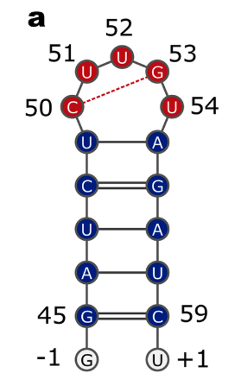
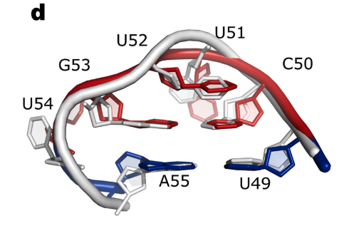
MPRO | Paper SARS2 5’UTR de novo 3D models + MD
Results:
SL2 sequence: GGAUCUCUUGUAGAUCU (same sequence but with extra GG at the beginning)
After 10 ns, we apply a biasing force (in a process we term “pulling”) to promote the formation of an ideal A-form RNA structure in the region where the secondary structure is known (blue nucleotides in Figure 2a)
Nucleic-acids-speciﬁc distance called ellipsoidal root-mean-square distance (eRMSD)
A three-dimensional cluster analysis 50 reveals that the largest cluster (∼90%) is remarkably similar to the available NMR loop structure from SARS-CoV-1,16 whose sequence diﬀers from our construct in the two terminal base-pairs.
20/09/2023
Bottaro, S., et al. (2021). Journal of the American Chemical Society, 143(22), 8333–8343. https://doi.org/10.1021/jacs.1c01094

Slide 43
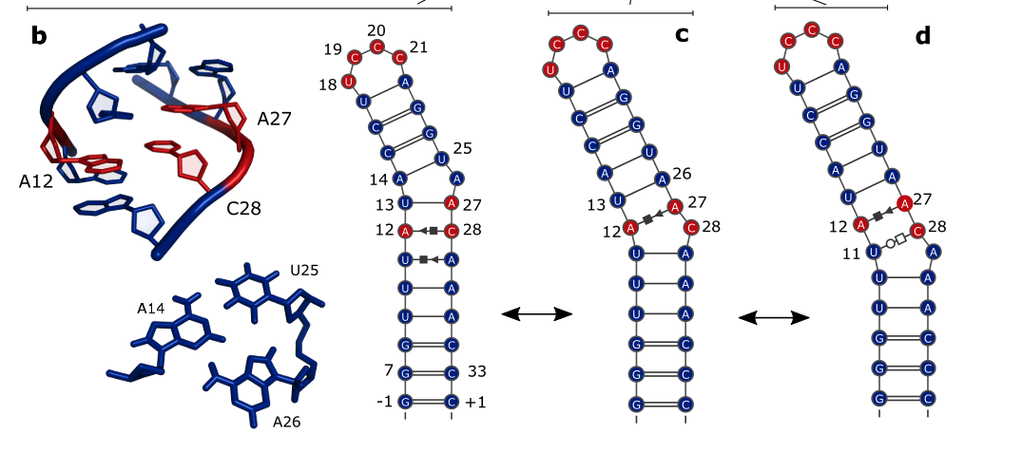
MPRO | Paper SARS2 5’UTR de novo 3D models + MD
Results:
SL1 consists of two helices connected by an asymmetrical internal loop
While U13−A26/U17−A22 base pairs could not be conﬁrmed by NMR, we have included these two interactions for generating the initial structures, as they were present in previous consensus secondary structure assignments
20/09/2023
Bottaro, S., et al. (2021). Journal of the American Chemical Society, 143(22), 8333–8343. https://doi.org/10.1021/jacs.1c01094

Slide 44
MPRO | Paper SARS2 5’UTR de novo 3D models + MD
Results:
While helix 1 is stable, the terminal base-pair U11−A29 interacts through either the Watson−Crick/Watson−Crick or Hoogsteen−sugar edges (Figure 4b). The presence of this noncanonical interaction allows the formation of a A12−C28 sugar−Hoogsteen interaction as well as of a U13−A27 basepair. A26 is not completely solvent-exposed, but forms a base triple together with A14 and U25.
In our simulations we also observe two alternative, lowly populated secondary structures (Figure 4c,d) where A12−A27/U13−-A26 are base-paired, and either C28 or A29 is partially excluded from the stack.
The apical loop is highly dynamic and lacks a major, stable conformation with speciﬁc base−base interactions. The U17−A22 base-pair interconverts from Watson−Crick/Watson−Crick to sugar/Hoogsteen, and U18 can engage a sugar−Hogsteen interaction with C21, albeit with a small population
20/09/2023
Bottaro, S., et al. (2021). Journal of the American Chemical Society, 143(22), 8333–8343. https://doi.org/10.1021/jacs.1c01094

Slide 45
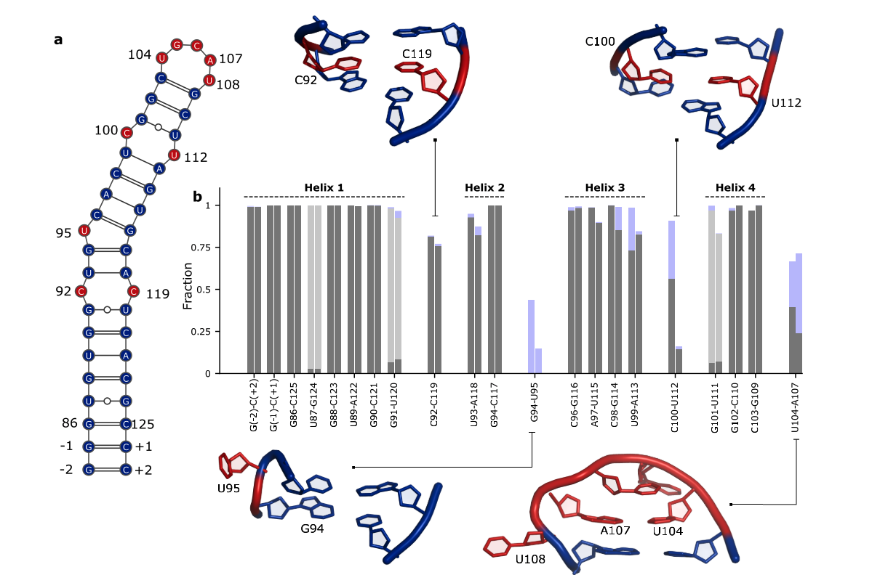
MPRO | Paper SARS2 5’UTR de novo 3D models + MD
Results:
SL4
20/09/2023
Bottaro, S., et al. (2021). Journal of the American Chemical Society, 143(22), 8333–8343. https://doi.org/10.1021/jacs.1c01094

Slide 46
MPRO | Paper SARS2 5’UTR de novo 3D models + MD
Results:
SL4 consists of four A-form helices of diﬀerent lengths linked by short pyrimidine internal loops and capped by a UGCAU pentaloop
The A-form geometry between helix 1 and helix 2 is stabilized by a WC/WC C92−C119 base-pair
U95 is solvent-exposed and transiently engages in noncanonical interactions with G94
In the ﬁrst run C100 preferentially base-pairs with U112, while in the second run additional conﬁgurations are sampled, where either C100 or U112 is not in the stack.
Experimental NMR measurements on SL4 agree with A-form helix compatible arrangement of the opposing residues C100 and U112,11 thus supporting the presence of pairing between the two bases.
The apical loop structure resembles a tetraloop with U108 solvent-exposed and U104:A107 forming either a Watson−Crick/Watson−Crick or a sugar/Hogsteen noncanonical interaction
20/09/2023
Bottaro, S., et al. (2021). Journal of the American Chemical Society, 143(22), 8333–8343. https://doi.org/10.1021/jacs.1c01094

Slide 47
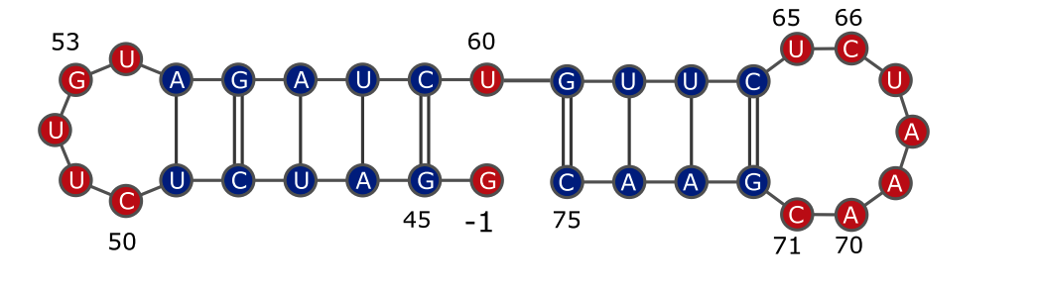
MPRO | Paper SARS2 5’UTR de novo 3D models + MD
Results:
SL2+SL3
20/09/2023
Bottaro, S., et al. (2021). Journal of the American Chemical Society, 143(22), 8333–8343. https://doi.org/10.1021/jacs.1c01094

Slide 48
MPRO | Paper SARS2 5’UTR de novo 3D models + MD
Results:
the SL2+SL3 construct, consisting of two consecutive stem-loop structures: SL2 (described above) and SL3, which contains the important transcription-regulating sequence required for subgenomic viral RNA synthesis
Although we did not enforce this geometry, we ﬁnd structures where the two helices are stacked coaxially tail-to-tail, thereby forming a unique A-form-like stem.
The SL2 loop conformations are similar to those observed for SL2 alone, with a stable C50−G53
The UCUAAAC heptaloop in SL3 is highly ﬂexible and adopts several conformations that are partially structured in terms of base-pairing
A cluster analysis of SL3 conformations reveals the presence of a loop structure where U65 forms a stacking interaction with C66, followed by the strand inversion and by two consecutive stackings between A68−A69−A70.
The tail-to-tail structure observed in simulations, which may not form in the context of the full 5′-UTR construct, may overstabilize helix 2 in this construct.
20/09/2023
Bottaro, S., et al. (2021). Journal of the American Chemical Society, 143(22), 8333–8343. https://doi.org/10.1021/jacs.1c01094

Slide 49
MPRO | Paper SARS2 5’UTR de novo 3D models + MD
Conclusions:
A principal component analysis of the structures generated for SL1 and SL2 shows small overlap between FARFAR2 and MD ensembles, suggesting the two methods to be complementary (SI7).
In the case of SL2, the MD predictions mostly agree with the available NMR data, although small discrepancies remain. For this structure FARFAR2 does not predict the experimental loop architecture with the C50−G53 base-pair (SI1), and it thus appears that the ensemble generated by MD provides a more accurate description in this case.
Moreover, the overall high agreement between the two independent simulations suggests that the conformational ensembles are relatively well converged.
The modeling protocol used in the present study implicitly considers helix formation and internal loop dynamics as partially decoupled events.
20/09/2023
Bottaro, S., et al. (2021). Journal of the American Chemical Society, 143(22), 8333–8343. https://doi.org/10.1021/jacs.1c01094

Slide 50
MPRO | Paper SARS2 5’UTR de novo 3D models + MD
Conclusions:
Despite recent improvements of RNA force ﬁelds, the accuracy of the simulation results still depends on the accuracy of the physical models used, and we have validated our simulations against available experimental data. As more data become available, we note that it should be straightforward to integrate our extensive conformational sampling with data from future solution measurements (e.g., NMR or SAXS)38−40 to reﬁne the atomic-level description of SARS-CoV-2 RNA structure and dynamics.
20/09/2023
Bottaro, S., et al. (2021). Journal of the American Chemical Society, 143(22), 8333–8343. https://doi.org/10.1021/jacs.1c01094

Slide 51
MPRO | Paper Small molecules targeting RNA dynamic ensembles
Introduction:
Most ncRNAs are non-enzymatic, making it difficult to directly screen for inhibitors.
HTS assays targeting RNA often yield hits with low specificity, unfavorable pharmacological properties, and/or poor activity in cell-based assays.
Additionally, libraries used in HTS are biased to compounds that bind the deep hydrophobic pockets of proteins, not the polar and solvent exposed pockets typical of RNA targets.
However, applying virtual screening (VS) to RNA drug targets is complicated by the high flexibility of RNA and its propensity to undergo large conformational changes upon small-molecule binding.
The receptor is treat as an ensemble of many conformations each of which is subjected to VS
In RNA MD because of the much higher flexibility of RNA, there is a greater risk of including artifactual conformations in the ensemble that are rarely sampled in solution, leading to false positives in VS. There is also a greater risk of not sampling conformers with favorable binding pockets because of RNA’s more rugged energy landscape and high propensity for kinetic traps, thus increasing the likelihood of false negatives.
21/09/2023
Ganser, L. R., et al. (2018). Nature structural & molecular biology, 25(5), 425–434. https://doi.org/10.1038/s41594-018-0062-4

Slide 52
MPRO | Paper Small molecules targeting RNA dynamic ensembles
Introduction:
Recent approaches that combine experimental data with computational methods are making it possible to determine ensembles of proteins and nucleic acids at atomic resolution
ensemble-based VS (EBVS) using experimentally informed ensembles
These include the first example of a small molecule that binds an RNA apical loop and an aminoglycoside that binds TAR with high selectivity, inhibiting HIV replication
Results:
They first did a Experimental high-throughput screening to identify TAR hits and nonhits. Using a Tat peptide displacement assay we subjected HIV-1 TAR (Fig. 1a) to experimental HTS against ~100,000 drug-like molecules.
The 2,812 primary screen hits were subjected to a secondary confirmation screen employing triplicate measurements
The 267 confirmed hits were tested in dose–response assays yield-ing 17 hits with competitive doses to displace 50% of Tat peptide (CD50) values < 100 μM
21/09/2023
Ganser, L. R., et al. (2018). Nature structural & molecular biology, 25(5), 425–434. https://doi.org/10.1038/s41594-018-0062-4

Slide 53
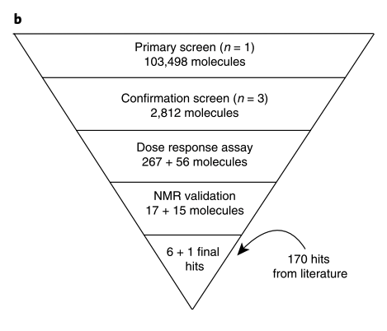
MPRO | Paper Small molecules targeting RNA dynamic ensembles
Results:
Finally NMR yielded 6 confirmed hits
They increase this 6 hits with 170 confirmed hits of the literature.
To avoid bias and maximize chemical diversity, the 177 hits were clustered based on Bemis-Murcko atomic frameworks, and the compound with highest affinity selected as a representative of each scaffold.
This resulted in the ‘Full’ library consisting of 78 hits and 103,349 nonhits
On average, the hits, which include several aminoglycosides, have larger molecular weights, larger charges, higher numbers of rotatable bonds, more hydrogen bond donors and acceptors, and lower log(P) values.
21/09/2023
Ganser, L. R., et al. (2018). Nature structural & molecular biology, 25(5), 425–434. https://doi.org/10.1038/s41594-018-0062-4

Slide 54
MPRO | Paper Small molecules targeting RNA dynamic ensembles
Results:
They generated two additional property-matched libraries that provide a more stringent test for docking-based enrichment
A ‘Filtered’ library, containing 26 hits (8 with cell-based activity) and 102,307 nonhits, was generated by omitting small molecules with outlier chemical properties
An ‘Optimized’ library, containing 14 hits (5 with cell-based activity) and 637 nonhits, was generated following the general protocol for decoy generation used in the DUD-E
Second EBVS was carried out against a recently reported RDC-informed dynamic ensemble. The ensemble contains 20 unique and equally populated (5% each) conformations
The TAR ensemble displays a high degree of flexibility; the pairwise r.m.s. deviation (RMSD) between any two conformations is > 1.9 Å and on average 5.9 Å. This substantially exceeds the flexibility of most protein targets, presenting a considerable challenge to docking based approaches.
21/09/2023
Ganser, L. R., et al. (2018). Nature structural & molecular biology, 25(5), 425–434. https://doi.org/10.1038/s41594-018-0062-4

Slide 55
MPRO | Paper Small molecules targeting RNA dynamic ensembles
Results:
Each small molecule was docked against every TAR conformer using internal coordinate mechanics
Each small molecule was assigned a docking score corresponding to the best score across the 20 conformers, a Boltzmann-weighted average score, or an arithmetic average score
For the Full library, optimal enrichment was obtained using the Boltzmann average or best score, whereas the arithmetic average yielded slightly better enrichment for the Filtered and Optimized libraries
EBVS globally enriched the Full library with ROC AUC = 0.88, and 42% of hits were identified after screening only 2% of non-hits. This corresponds to a hit rate of 1.6% as compared to 0.075% when screening the entire library, and an enrichment factor (EF2%) of 21.
The enrichment was lower for individual TAR conformers derived from the ensemble and decreased further for single conformers randomly selected from the MD pool
21/09/2023
Ganser, L. R., et al. (2018). Nature structural & molecular biology, 25(5), 425–434. https://doi.org/10.1038/s41594-018-0062-4

Slide 56
MPRO | Paper Small molecules targeting RNA dynamic ensembles
Conclusions:
While an ensemble of structures can often be identified that outperforms single X-ray or NMR structures in retrospective enrichment studies, identifying the successful ensemble in advance of VS can prove difficult
Our results emphasize the potential importance of conformational penalties when developing and testing scoring functions against highly flexible RNA targets
Additionally, experimental data can define an optimally small ensemble for VS applications, whereas there is no general recipe for selecting ensemble size without experimental input
21/09/2023
Ganser, L. R., et al. (2018). Nature structural & molecular biology, 25(5), 425–434. https://doi.org/10.1038/s41594-018-0062-4

Slide 57
MPRO | Paper Small molecules targeting RNA dynamic ensembles
Results:
Docking against the lowest energy NOE-based structure of free TAR (PDB 1ANR)41 generally performed better than other single conformers, but consistently worse than EBVS
On average, enrichment decreased when using smaller subensembles derived from the full N = 20 ensemble, reaching a minimum at N = 1
This is despite the fact that increasing the ensemble size increases the risk of including artifactual conformations that can lead to false positives
Taken together, these results highlight how a given conformer can contribute positively to enrichment when placed within an appropriate subensemble, even though it may have poor enrichment when considered in isolation or in a different ensemble context
21/09/2023
Ganser, L. R., et al. (2018). Nature structural & molecular biology, 25(5), 425–434. https://doi.org/10.1038/s41594-018-0062-4

Slide 58
MPRO | DRfold
Website:
Intro
RNA molecules are essential for regulating gene expression, transcription, scaffolding, and catalytic processes, among other key cellular processes.
It is crucial to clarify the precise tertiary structures of RNA molecules in order to use them as pharmacological targets or to comprehend how they work within the body.
Traditional RNA structure prediction techniques use simulations or homology modeling
Effectiveness of homology-based approaches, such as ModeRNA and RNABuilder, for various RNA targets, is reduced since they pull structure information from previously solved homologous structural templates.
Statistical potentials are used by ab initio RNA structure prediction techniques like SimRNA and FARFAR to direct structure folding simulations.
Method
DRfold, a unique deep learning pipeline aiming at enhancing Ab-initio RNA structure prediction, was introduced as a result of the success of deep learning in 3D protein structure prediction.
Due to the scarcity of RNA structures, DRfold uses a coarse-grained model for RNA instead of the full-atom, end-to-end training used for proteins. The phosphate P, ribose C4′, and glycosidic N atoms of the nucleobase are the only particular atoms taken into account by this model.
26/09/2023
Li, Y., Zhang, et al (2023). Nature communications, 14(1), 5745.

Slide 59
MPRO | DRfold
Website:
Method
A query sequence and its anticipated secondary structure (SS) are entered to start the process.
An embedding layer uses this data to create crucial sequence and pair representations. These embedded representations are processed by 48 RNA transformer blocks, supplying energy for the following processes.
The RNA transformer building blocks have two functions. First, by permitting nucleotide-wise rotation matrices and translation vectors, and second, they aid end-to-end RNA global-frame training. In the meantime, a different but related collection of transformer blocks is used to predict the inter-nucleotide geometry of RNA using the pair representations produced from the transformer blocks.
The predictive outputs from the previous steps, namely the frame vectors and geometric restraints, are amalgamated into a composite potential.
This potential is instrumental in guiding RNA structure reconstruction through a gradient-based optimization process. The primary objective of this optimization is to identify the RNA conformation with the lowest energy, which is subsequently selected as the output model.
To enhance the precision and reliability of the models, the coarse-grained representations of the RNA structures generated by the pipeline undergo a meticulous refinement procedure.
26/09/2023
Li, Y., Zhang, et al (2023). Nature communications, 14(1), 5745.

Slide 60
MPRO | DRfold
Website:
Method
This procedure leverages a two-step molecular dynamics-based approach, which aids in atomic-level structure reconstruction and fine-tuning.
In the DRfold RNA structure prediction pipeline, two crucial types of potentials, FAPE, and geometry potentials, are derived from separate transformer networks, providing essential complementary information.
Results
The FAPE potential facilitates end-to-end learning, directly predicting rotation matrices and translation vectors for nucleotide frames, significantly enhancing the prediction performance.
When considering only geometry potentials for structure optimization, the performance drops significantly, underscoring the importance of the end-to-end potential.
Moreover, incorporating end-to-end and geometry potentials collectively improves the quality of DRfold models, demonstrating the synergy of these complementary approaches.
In DRfold, utilizing predicted secondary structure (SS) is vital for accurate RNA tertiary structure prediction. Comparisons highlight a substantial drop in TM-score when SS predictions are excluded.
26/09/2023
Li, Y., Zhang, et al (2023). Nature communications, 14(1), 5745.

Slide 61
MPRO | DRfold
Website:
Results
DRfold employs a two-step refinement process from coarse-grained to atomic-level models to enhance the accuracy and biological relevance of predicted RNA structures. The initial coarse-grained models exhibit high clash and MolProbity scores, indicating structural inaccuracies. After refinement using molecular dynamics and minimization, clash and MolProbity scores significantly improved, aligning the model quality more closely with experimental structures
26/09/2023
Li, Y., Zhang, et al (2023). Nature communications, 14(1), 5745.

Slide 62
MPRO | DRfold
Website:
Comparison
In a comparative evaluation with representative control methods, including RNAComposer, 3dRNA, SimRNA, RNA-BRiQ, and FARFAR, DRfold consistently demonstrates superior performance.
DRfold significantly outperforms control methods in terms of RMSD, showcasing an average RMSD of 14.45 Å, notably lower than all control methods.
Furthermore, DRfold excels in TM-score, with an average of 0.435, a remarkable 73.3% higher than the second-best method, 3dRNA.
Additionally, DRfold achieves a high success rate of correct folds, with 45% of models exhibiting TM-scores greater than 0.45, surpassing the best control method’s success rate of 12.5%.
DRfold exhibits a superior ability to recover base interaction networks and maintain the correct chirality of RNA helices.
The method incorporates end-to-end and geometry-based approaches through potential integration, offering flexibility for pipeline growth. Notably, DRfold shows its effectiveness without relying on complicated MSAs by outperforming single sequence-based approaches and competing with MSA-based techniques.
26/09/2023
Li, Y., Zhang, et al (2023). Nature communications, 14(1), 5745.

Slide 63
MPRO | DRfold
Article:
Introduction
it is estimated that targeting RNAs with small molecules will expand the drug design landscape by more than an order of magnitude compared to tradi- tional protein-targeted drug discovery
Different from the full-atom end-to-end training in proteins, we adopted a coarse-grained model of RNA specified by the phosphate P, ribose C4’, and glycosidic N atoms of the nucleobase, for training efficiency given the limited availability of RNA structures.
In particular, we added a geometric module which is trained in parallel to assist the end-to-end training, and meanwhile aggregated both end- to-end and geometric potentials to guide subsequent RNA structure reconstruction simulations
26/09/2023
Li, Y., Zhang, et al (2023). Nature communications, 14(1), 5745.

Slide 64
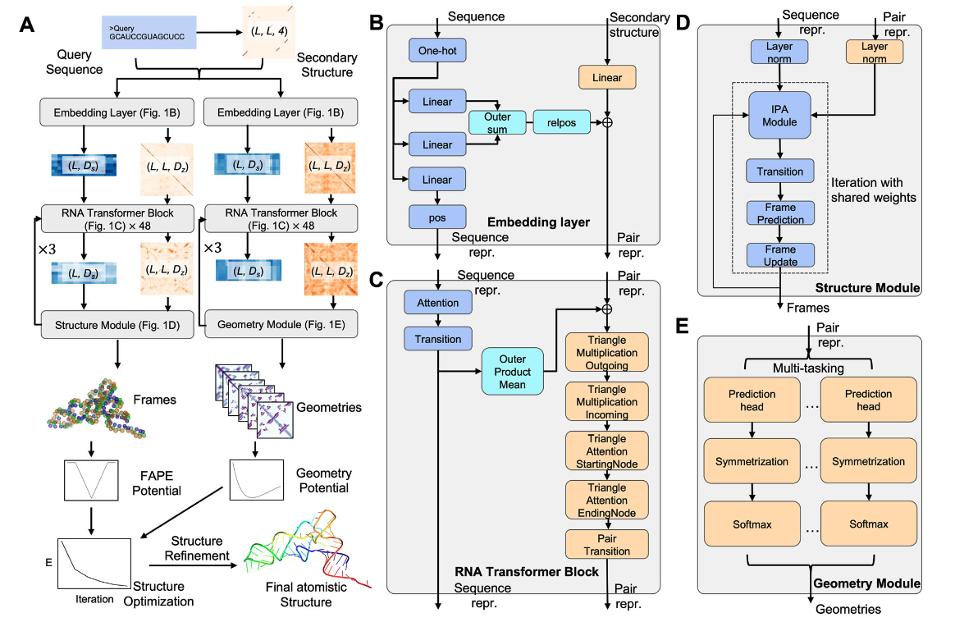
MPRO | DRfold
26/09/2023
Li, Y., Zhang, et al (2023). Nature communications, 14(1), 5745.

Slide 65
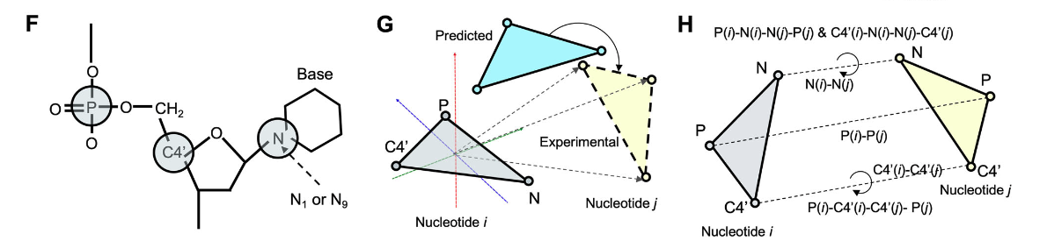
MPRO | DRfold
F Reduced representation of nucleotide residues by a 3-bead model (C4’, P, glycosidic N) in DRfold. G Illustration of the frame aligned point error (FAPE). H Prediction terms of inter-nucleotide geometry.
26/09/2023
Li, Y., Zhang, et al (2023). Nature communications, 14(1), 5745.

Slide 66
MPRO | DRfold
Article:
Results
The query sequence along with its SS predictions is first fed into an embedding layer which outputs the sequence and pair representations.
The embedded representations are then passed through 48 RNA transformer blocks and are used for end-to-end RNA global-frame training, in terms of nucleotide-wise rotation matrices and translation vectors, which can be used to recover the atomic coordinates of the RNA structure.
The pair representations are also used for RNA inter-nucleotide geometry prediction through a similar but independent set of transformer blocks.
Next, the predicted frame vectors and geometric restraints are aggregated into a composite potential for gradient-based RNA structure reconstruction, where the optimized conformation with the lowest energy is selected as the output model.
Finally, the coarse- grained models are submitted to a two-step molecular dynamics-based procedure for atomic-level structure reconstruction and refinement.
26/09/2023
Li, Y., Zhang, et al (2023). Nature communications, 14(1), 5745.

Slide 67
MPRO | SARS2 RNA-puzzle
Introduction
RNA serve as templates for protein translation, regulate gene expression on many levels, and govern most aspects of cell metabolism, thus being crucial regulators of physiological and disease processes
The dynamic nature of RNAs means that many functionally important native states of these molecules exist, such as folding intermediates or elements containing ﬂexible motifs.
identifying functional RNA structures is particularly difﬁcult and requires combining experimental and computational approaches
Results
First, we extracted secondary structures from 3D structure atom coordinates, and we prepared conservation logos.
27/09/2023
Gumna, J., et al. (2022). International journal of molecular sciences, 23(17), 9630.

Slide 68
MPRO | MD for RNA review
03/10/2023
Šponer, J., Bussi, G., et al. (2018). Chemical reviews, 118(8), 4177–4338.

Slide 69
MPRO | To do
Download and check the MD models from Bottaro, S., et al. (2021). Journal of the American Chemical Society, 143(22), 8333–8343. https://doi.org/10.1021/jacs.1c01094
Download and check the molecules from Angew. Chem. Int. Ed. 2021, 60, 19191– 19200 DOI: doi.org/10.1002/anie.202103693 and https://covid19-nmr.de/screening-targets/?category_name=targets-rna we need hits and no hits!
Test some rigid docking methods against SL1, SL2+3, SL2 and SL4 models using the downloaded molecules. ENSEMBLE DOCKING
Test PELE against SL1, SL2+SL3, SL2 and SL4 models:
Include the PARMC2 force field
First check and understand the movement of the nucleotides
Second check and understand the ANM movements
Third try to refine some docking poses and induce fit dockings
Run MD simulations with the PARMBSC2 force field to relax the models. Maybe we could take the center of the most populated clusters and after the MD generate our own ensemble.
Generate models with DRfold and then run MD simulations with PARMBSC2 to obtain ensembles
Generate models with DeepFoldRNA (it uses MSA instead of single sequences) and then run MD simulations with PARMBSC2 to obtain ensembles
21/09/2023

Slide 70
MPRO | Active/Inactive compounds for RNA (SL1, SL2, SL3, and SL4)
SUMMARY: number of compounds
Source* | Active/Inactive | SL1 | SL2 | SL3 | SL4 | SL1234 | TOTAL
Covid-19-NMR | Active | 5 | - | - | 7 | 5 | 17
 | Inactive | - | - | - | - | - | 0
Schwalbe | Active | 5 | 0 |  | 7 | 5 | 17
 | Inactive | 741 | 717 |  | 723 | 719 | 2900
Simba-Lahuasi | Active | - | 2 |  | - | - | 2
 | Inactive | - | 1 |  | - | - | 1
Zafferani | Active | 3 | - | - | 3 | - | 6
 | Inactive | - | - | - | - | - | 0
Experimentalists | Active | - | - | - | - | 6 | 6
 | Inactive | - | - | - | - | 3 | 3
TOTAL | Active | 13 | 2 |  | 15 | 16 | -
 | Inactive | 741 | 718 |  | 723 | 722 | -
*Covid-19-NMR: https://covid19-nmr.de/screening-targets/?category_name=targets-rna
Schwalbe: https://doi.org/10.1002/anie.202103693
Simba-Lahuasi: https://doi.org/10.3390/ph15121448
Zafferani: https://doi.org/10.1126/sciadv.abl6096
Experimentalists: sent by https://www.iqac.csic.es/mcs/about-us/core-team/
27/09/2023

Slide 71
MPRO | First MD simulation (Isaac)
SL2 structure from Bottaro, S., et al. (2021). Journal of the American Chemical Society, 143(22), 8333–8343. particularly the center of the cluster 0.
10 nanoseconds MD simulation performed with GROMACS 2023.2 and PARMBSC1 force field.
Preparation:
TIP3P water model
Cubic box of a-a+2 (maybe a bit bigger would be better)
Solvation with spc216
Neutral, with an ion concentration of 0.1M and a minimum distance between ions and RNA of 0.6nm
Energy minimization:
1 picosecond of minimization with a maximum force < 10 kJ/mol/nm
Equilibration:
nvt + npt of 100 picoseconds each
02/10/2023

Slide 72
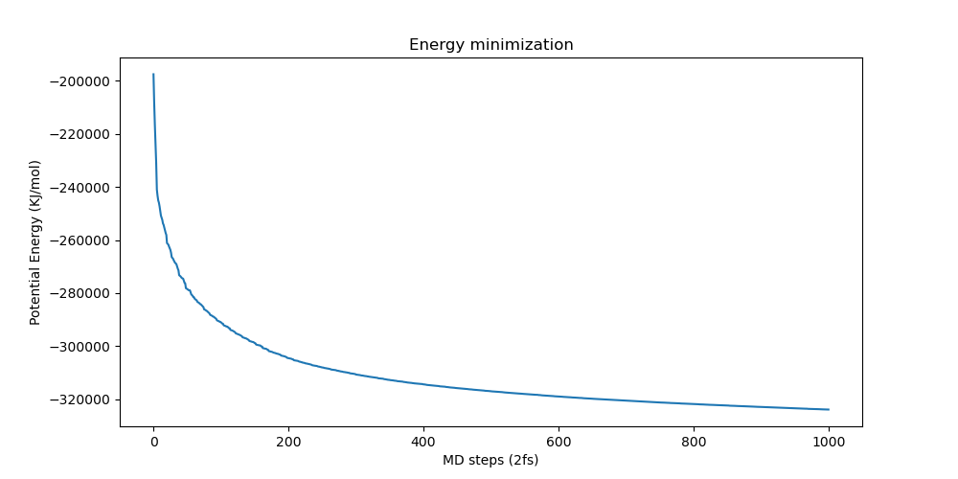
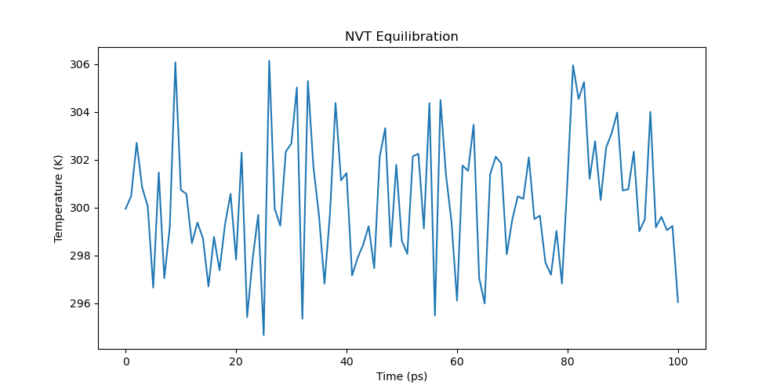
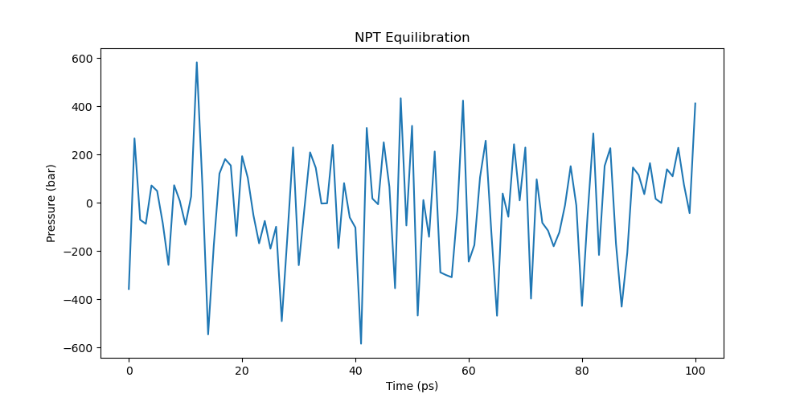
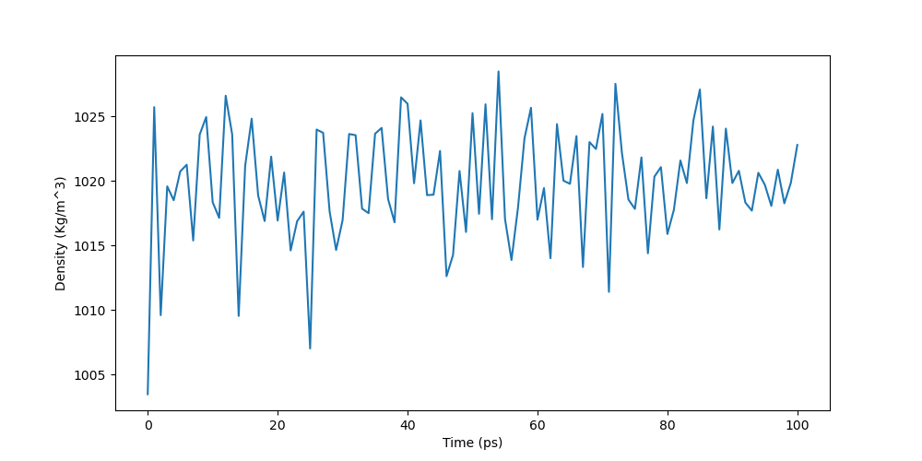
MPRO | First MD simulation (Isaac)
02/10/2023

Slide 73
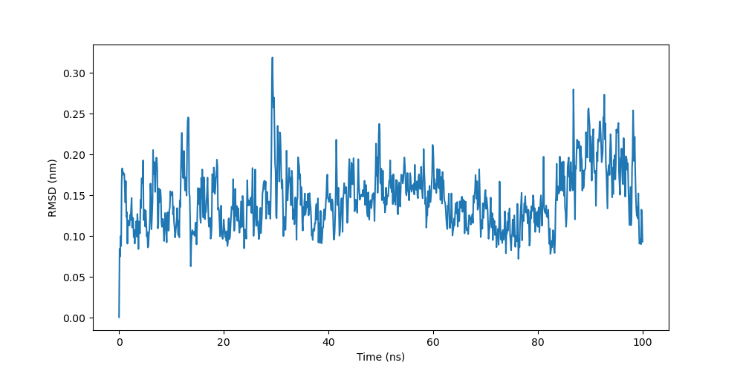
MPRO | First MD simulation (Isaac)
Whole SL2 RMSD
02/10/2023

Slide 74
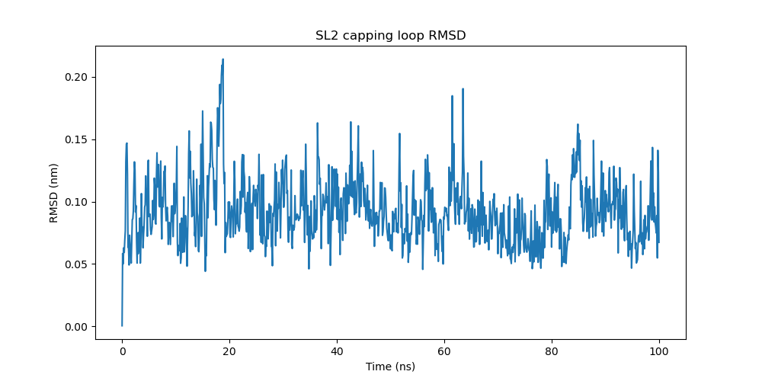
MPRO | First MD simulation (Isaac)
SL2 RMSD of the unpaired nucleotides / capping group (50-54)
02/10/2023

Slide 75
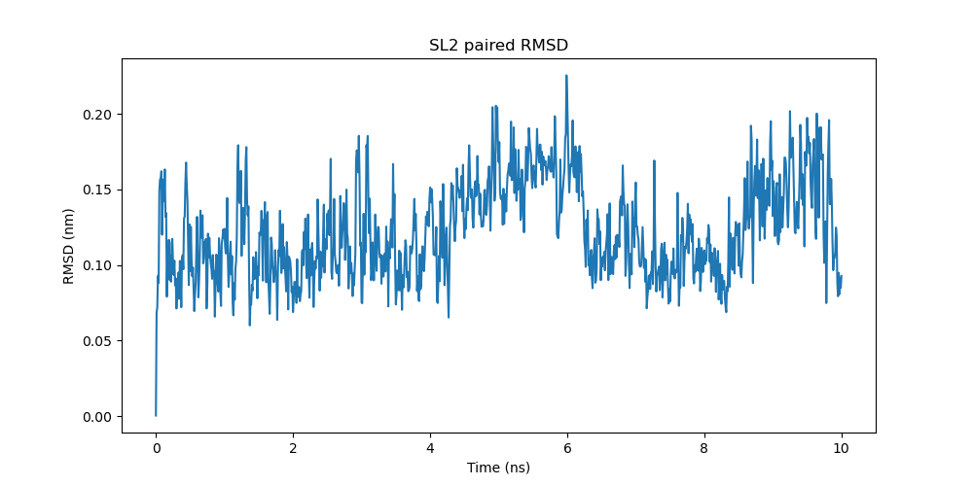
MPRO | First MD simulation (Isaac)
SL2 RMSD of the paired nucleotides (44-49 and 55-60)
02/10/2023

Slide 76
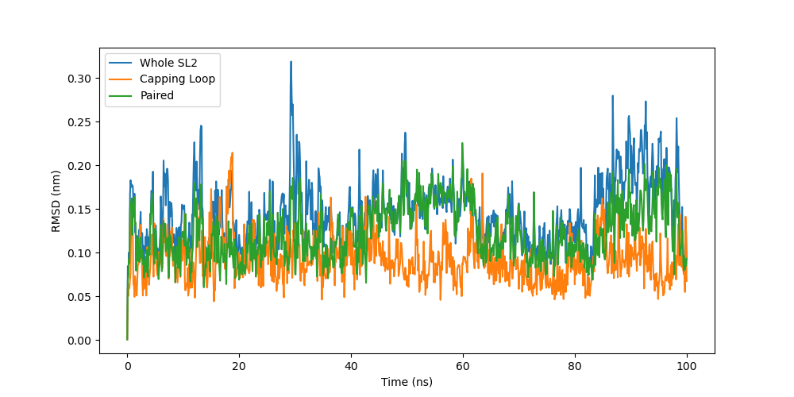
MPRO | First MD simulation (Isaac)
SL2 RMSD
02/10/2023

Slide 77
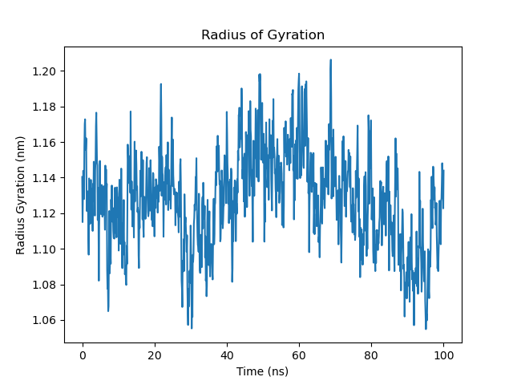
MPRO | First MD simulation (Isaac)
SL2 Radius of Gyration
02/10/2023

Slide 78
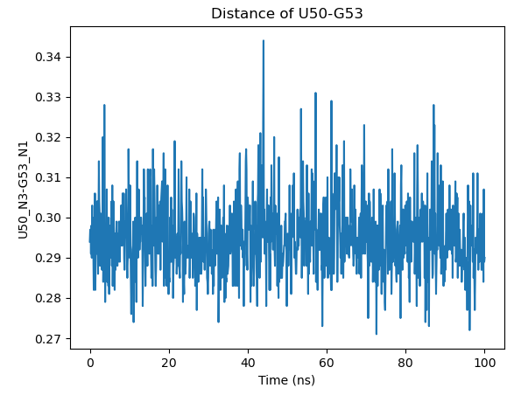
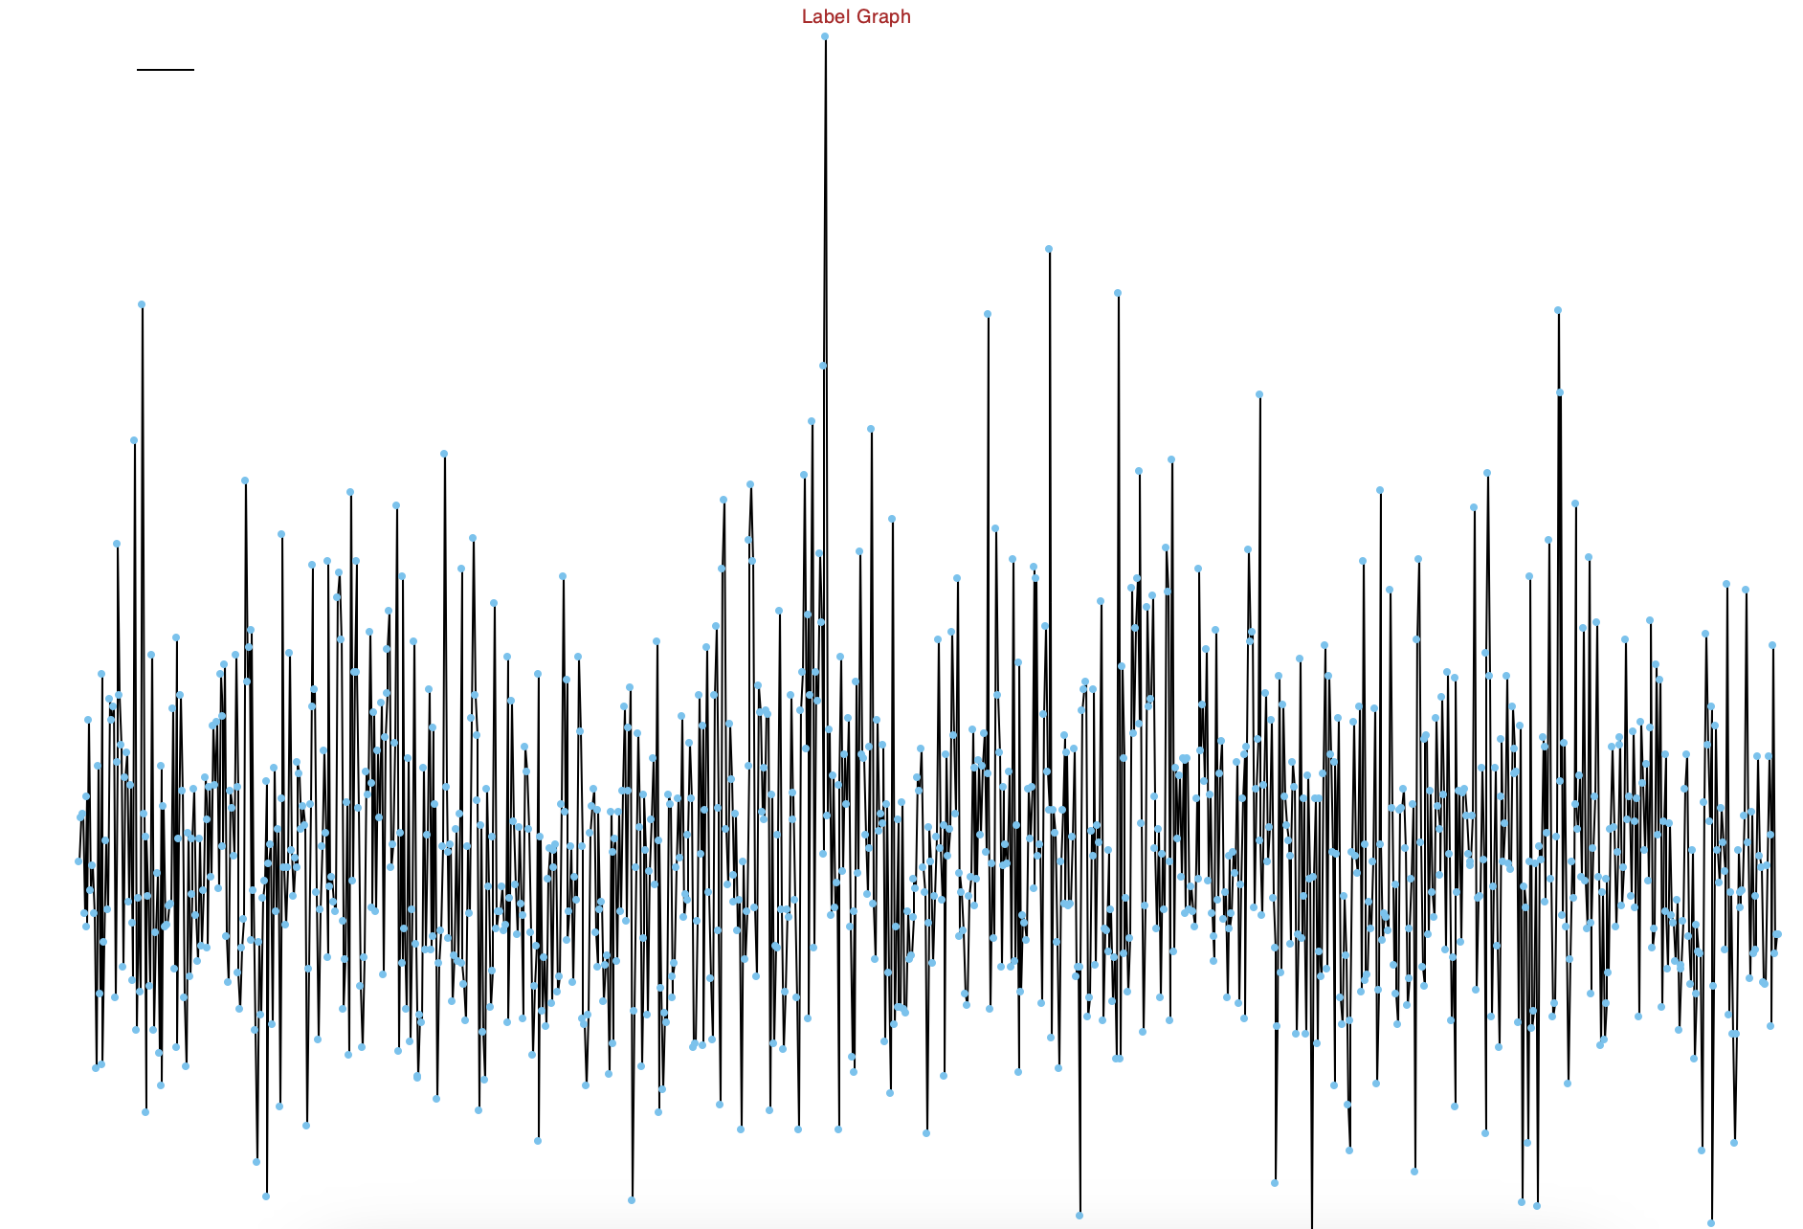
MPRO | First MD simulation (Isaac)
SL2 distance U50N3-G53N1
02/10/2023

